Slide 1

Google Analytics Case Study
“How does a bike-share navigate speedy success?”
Daniel Capehorn
February 2024
[Last Updated February 2024]

Slide 2
Business
Task
Table of Contents
Data Summary [3]
Headline Statistics [4]
Data Analysis [5-12]
Recommendations & Next Steps [13]
Appendix:
Evening Data [15-16]
Data cleaning / manipulation logs [17]
“How do annual members and casual riders use Cyclistic bikes differently?”

Slide 3
Data Summary
Data source
Data comprises 2019 Q1 & 2020 Q1
The data has been downloaded on 30th January 2024
The data is credible, robust, and comes from a trusted source
The data does not contain demographic information, nor does it contain anything which can contribute insights into the behaviour of users outside of the day, time and location of use
The type of data collected differs by dataset; it is appropriate for answering the business task but does not have scope for recommendations beyond this
The City of Chicago owns all right, title, and interest in the data
Further information can be sought under the license agreement
Notes:
For the purposes of this fictional case study, 2019 Q1 and 2020 Q1 data has been used as directed by Google.

Slide 4

How do people use Cyclistic?
Members
Casual
Mornings
Afternoons
Weekends
Afternoons
Weekdays
Tuesdays
Sundays
6-10 Mins
Canal St & Adams St
Streeter Dr & Grand Ave
21-30 Mins
Chicago Loop
West Loop
Lakefront Trail
Day Out
Commute
Notes:
[Interactive]: Ask audience how each group (members vs casual users) would be expected to use Cyclistic, prompt them with questions such as: when?; time of day?; who knows Chicago? - where might we expect to see Cyclistic being used?
Let me summarise what we are seeing here:
Members tend to be people who use Cyclistic to commute to work in the mornings – Tuesdays (and as we will see later), Wednesdays and Thursdays tend to be the most popular days, but we’ll look into that in more depth later. Canal St & Adams St is the most frequented station and the trips are quick, with most lasting 6-10 minutes.
Casual riders on the other hand tend to take more leisurely, 21-30 minutes rides at the weekend. They are using Cyclistic as part of a Sunday afternoon ride around the lakefront.

Slide 5
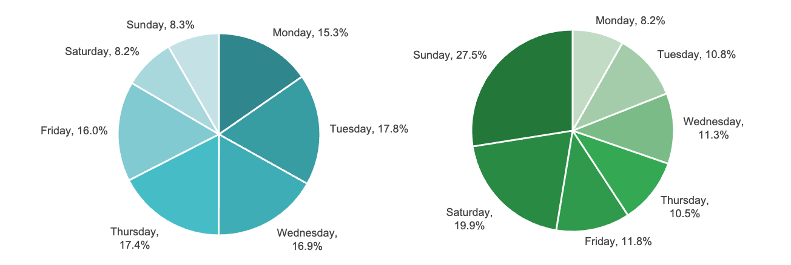
Which day is most popular?
Members
Casual
Notes:
So, which day of the week sees the most riders and how does this differ between members and casual users? Well, members use Cyclistic more throughout the week, and casual users at the weekend. In fact, nearly 50% of rides made by casual riders are over Saturday and Sunday.

Slide 6
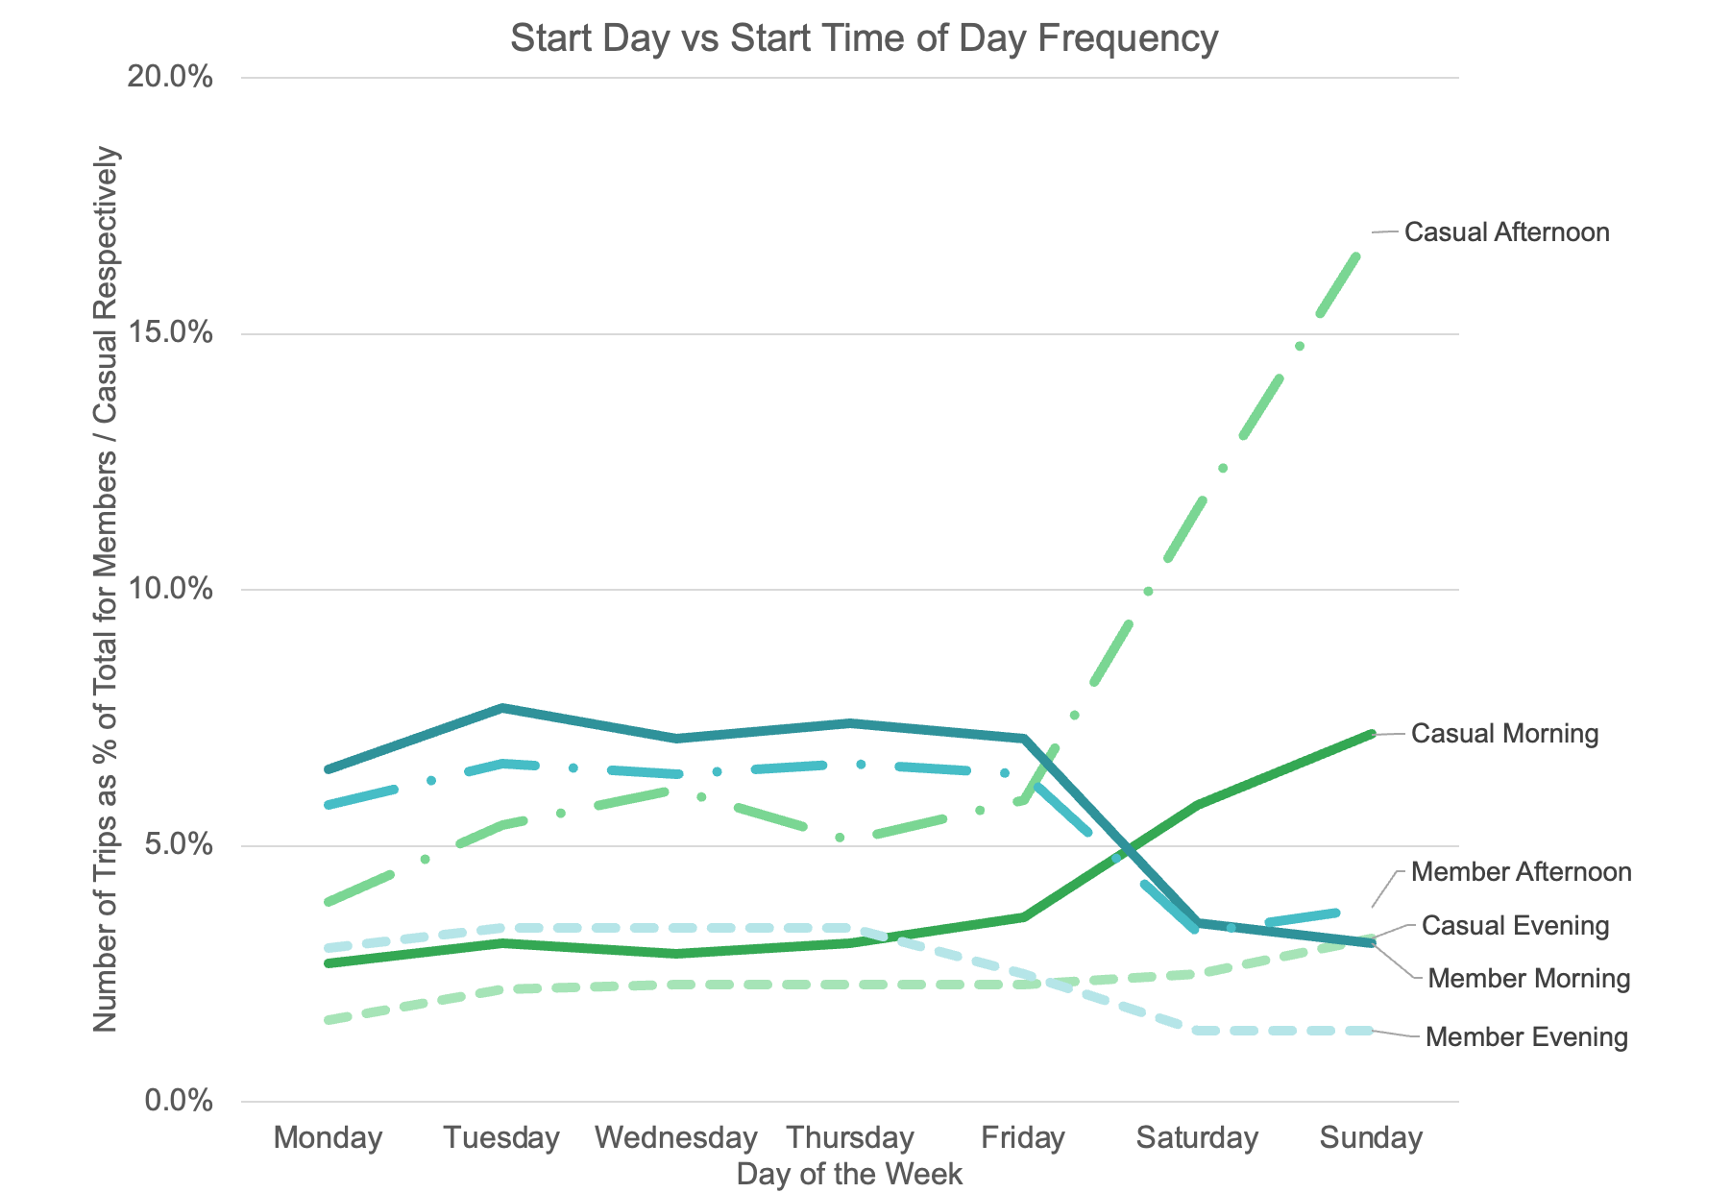
When is Cyclistic used?
 | Members | Casual
Trips | 715k | 67k
% of Total Trips | 91% | 9%
Evenings are relatively quiet for most of the week, therefore we will focus on morning and afternoon rides
Members tend to use Cyclistic more during the week vs casual users at weekends
Notes:
Let’s visualise this in a different way. As we can see from this chart, [members are the blue lines and casual riders green], evenings are relatively quiet for most throughout the whole week. However, members following the the 9-5 working week pattern can be seen slumping off at the weekend, to be replaced by casual riders. Some eager riders are up in the morning, but most take a leisurely Sunday and come out for a ride in the afternoon. From the data we have, 91% of trips overall are made by members rather than casual users. Despite the clear difference in rider behaviour across the two categories, members still make up the majority of weekend riders as we will see in the next slide.

Slide 7
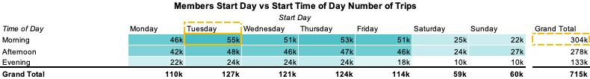
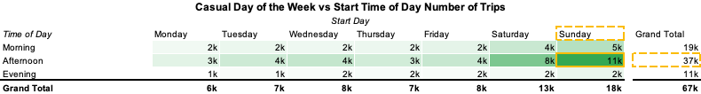
Numbers behind the trips
Notes:
Looking at the real figures behind the frequency, we can see that although there is a spike in ridership for casual riders at weekends, there is still more than double the amount of members using Cyclistic at the weekend compared to casual riders.
You’ll see the colour concentration indicates peaks and the figures are in thousands (k).

Slide 8
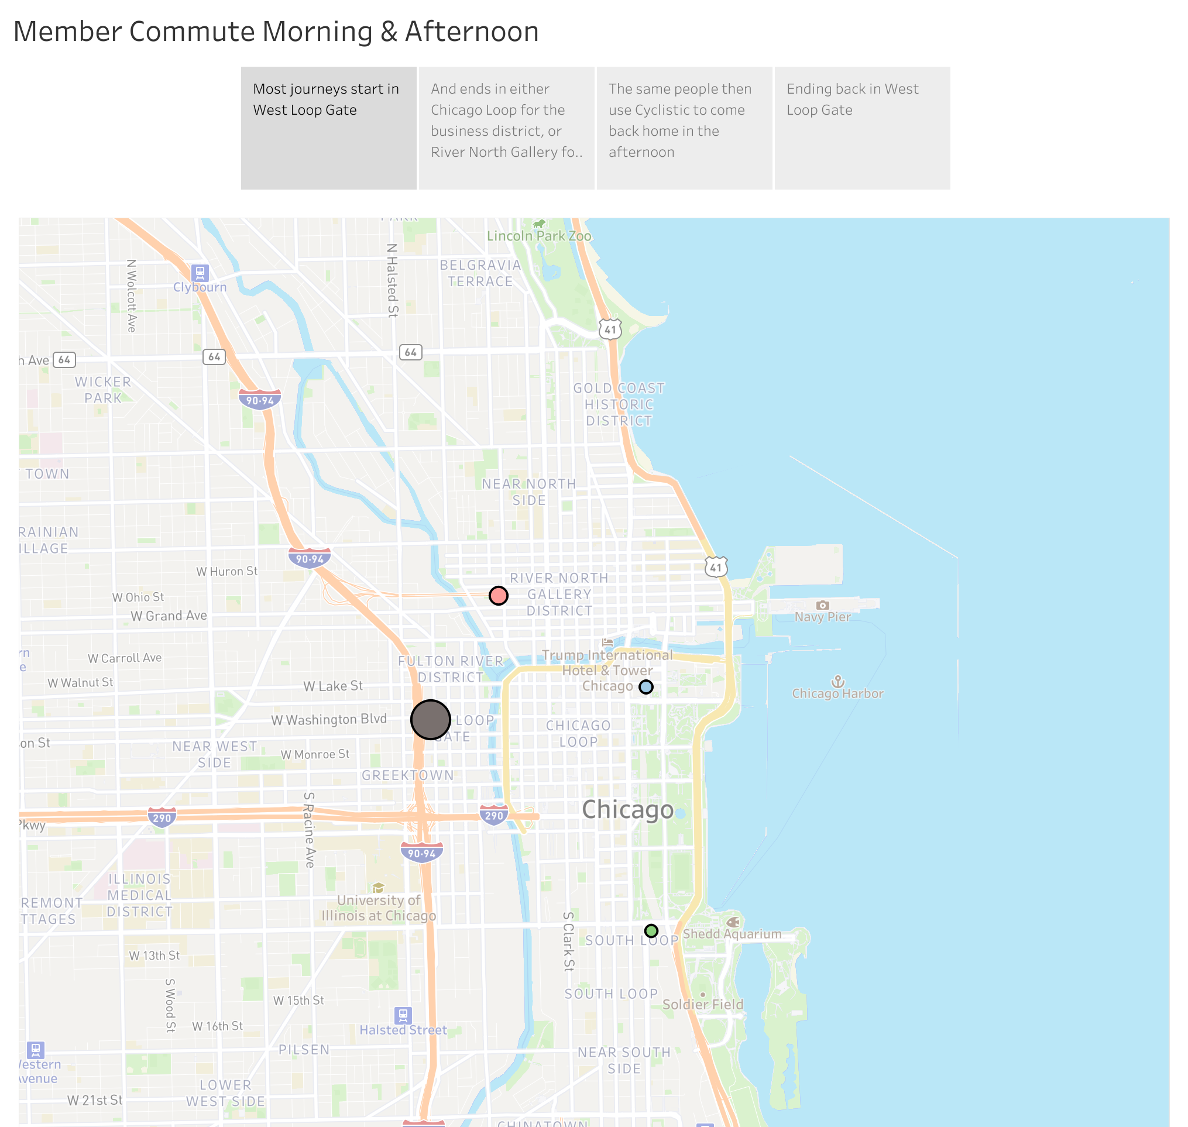
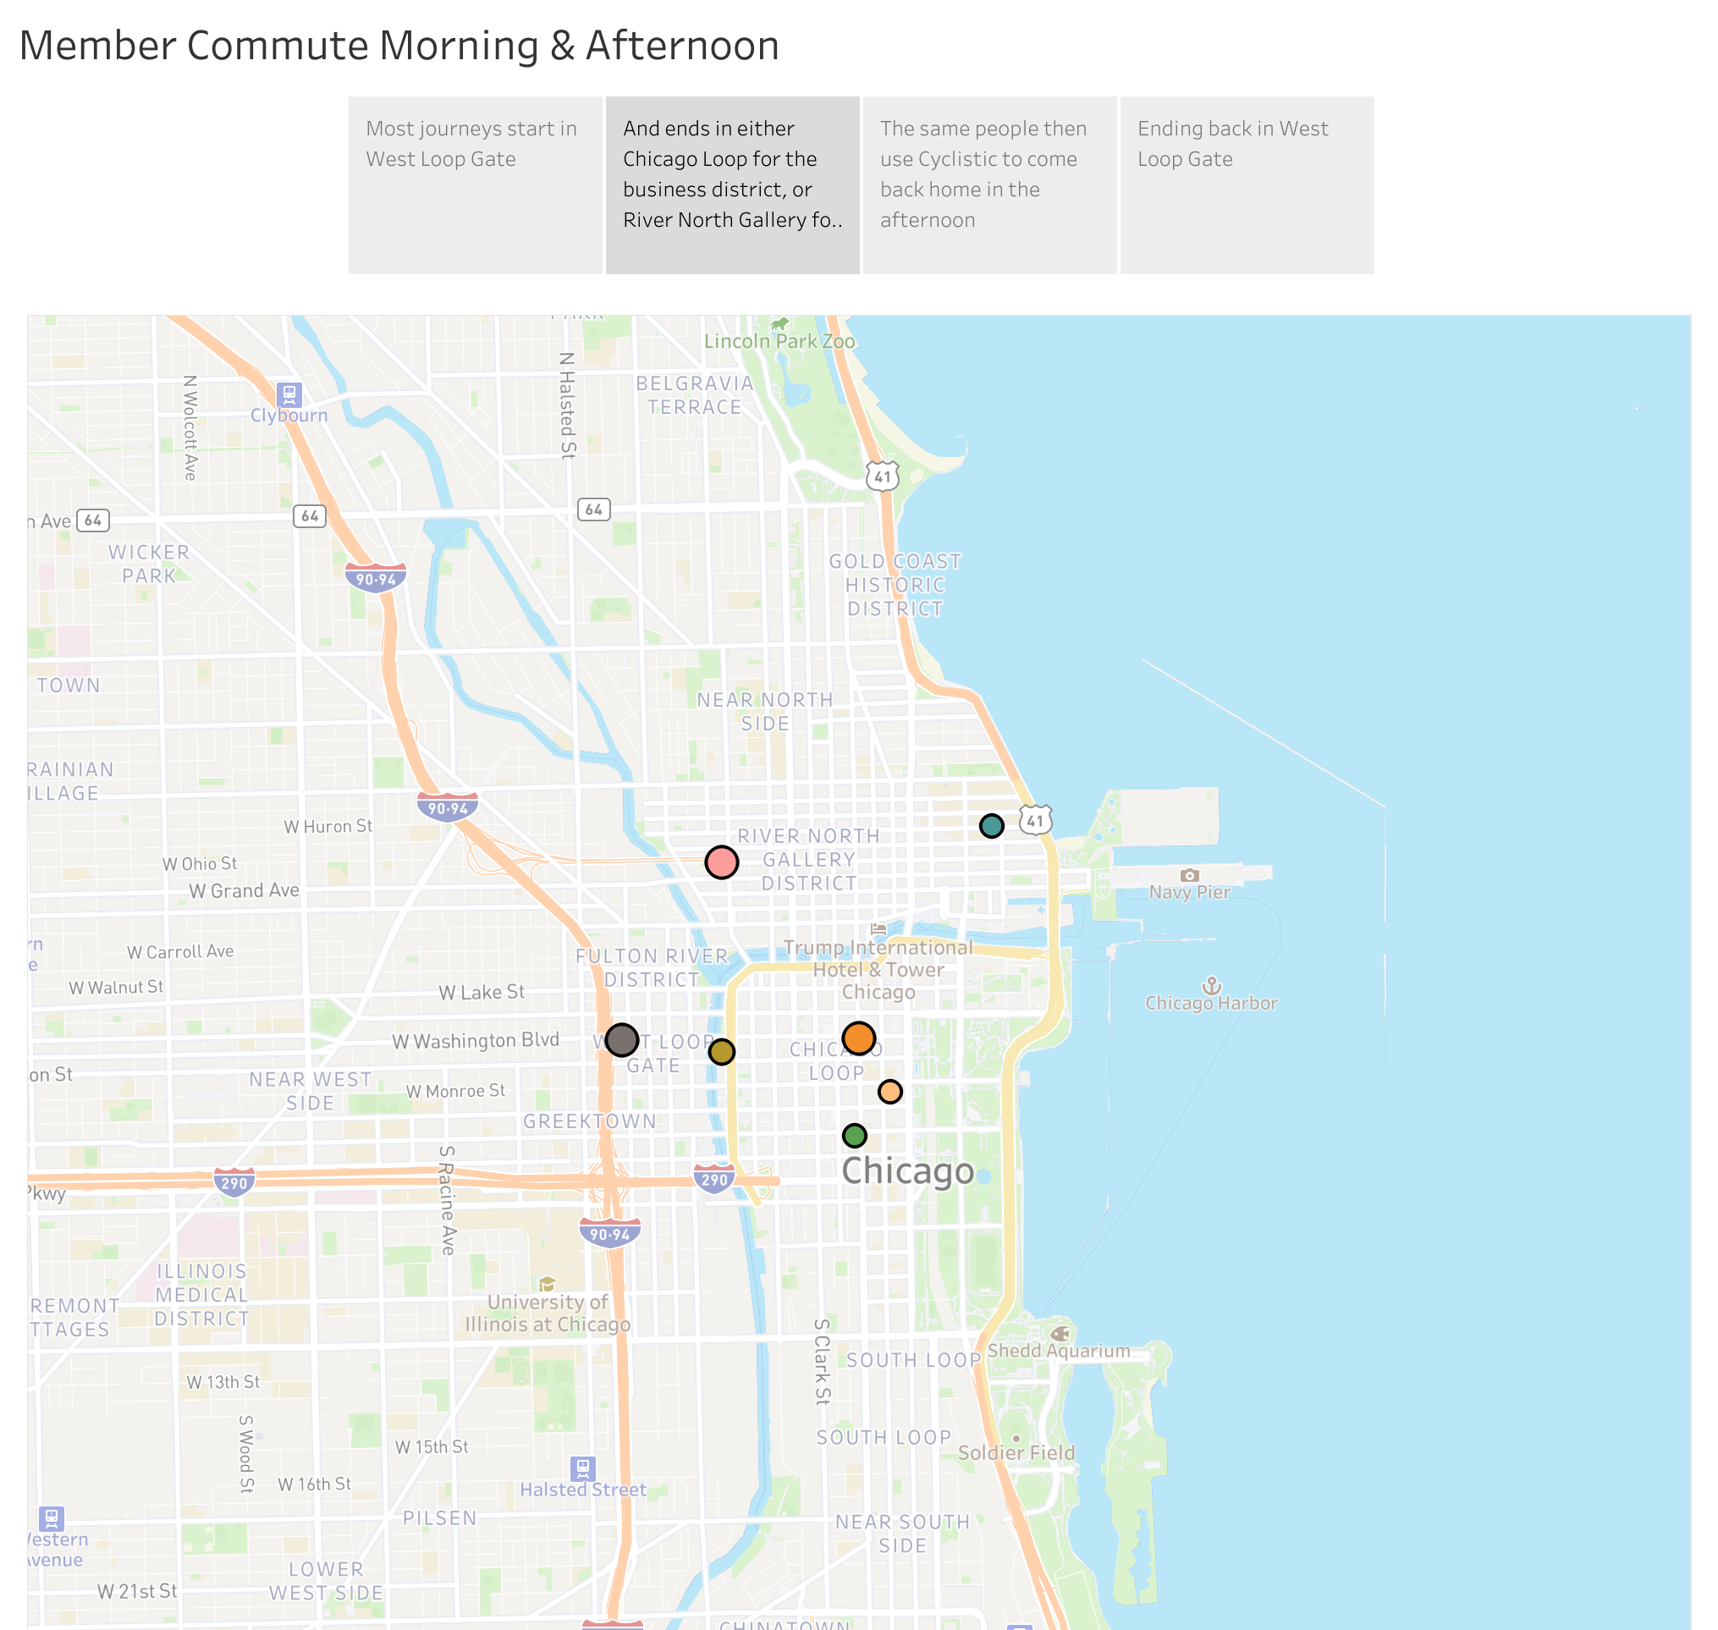
Morning commute – start to end
Most member journeys start at West Loop Gate in the morning
Morning Commute
And ends in either Chicago Loop for the business district, or River North Gallery for retail and leisure
Notes:
We can clearly see the story behind the morning commute when we add in data for where the most frequent end stations are. Most people start off in the West Loop Gate:
West Loop Gate is an urban, transit-oriented neighbourhood. You’ll find a busy, downtown neighbourhood filled with residents, commuters, and tourists. West Loop Gate is extremely walkable, and parking is hard to find unless you have a spot in your building's garage. With both Union Station and Ogilvie Station in the neighbourhood, we propose that both residents and those coming from out of town into the stations are then taking Cyclistic bikes to continue their journeys.
People end up dispersed throughout the Chicago Loop, which includes a portion of State Street, a major shopping district with several large department stores, and LaSalle Street (sometimes considered Chicago’s Wall Street), the location of several large financial institutions, including the Chicago Stock Exchange. There is also a concentration around River North Gallery district, home to tourist hotspots such as the Addington, Carl Hammer, Andrew Bae, and Jean Albano galleries; an area requiring a significant volume of workers to service.
Qualitative information sourced from:
https://www.aptamigo.com/IL/Chicago/Neighborhood/westLoopGate
https://www.britannica.com/place/the-Loop
https://www.luxurychicagoapartments.com/blog/spend-a-day-in-the-river-north-gallery-district-in-chicago/

Slide 9
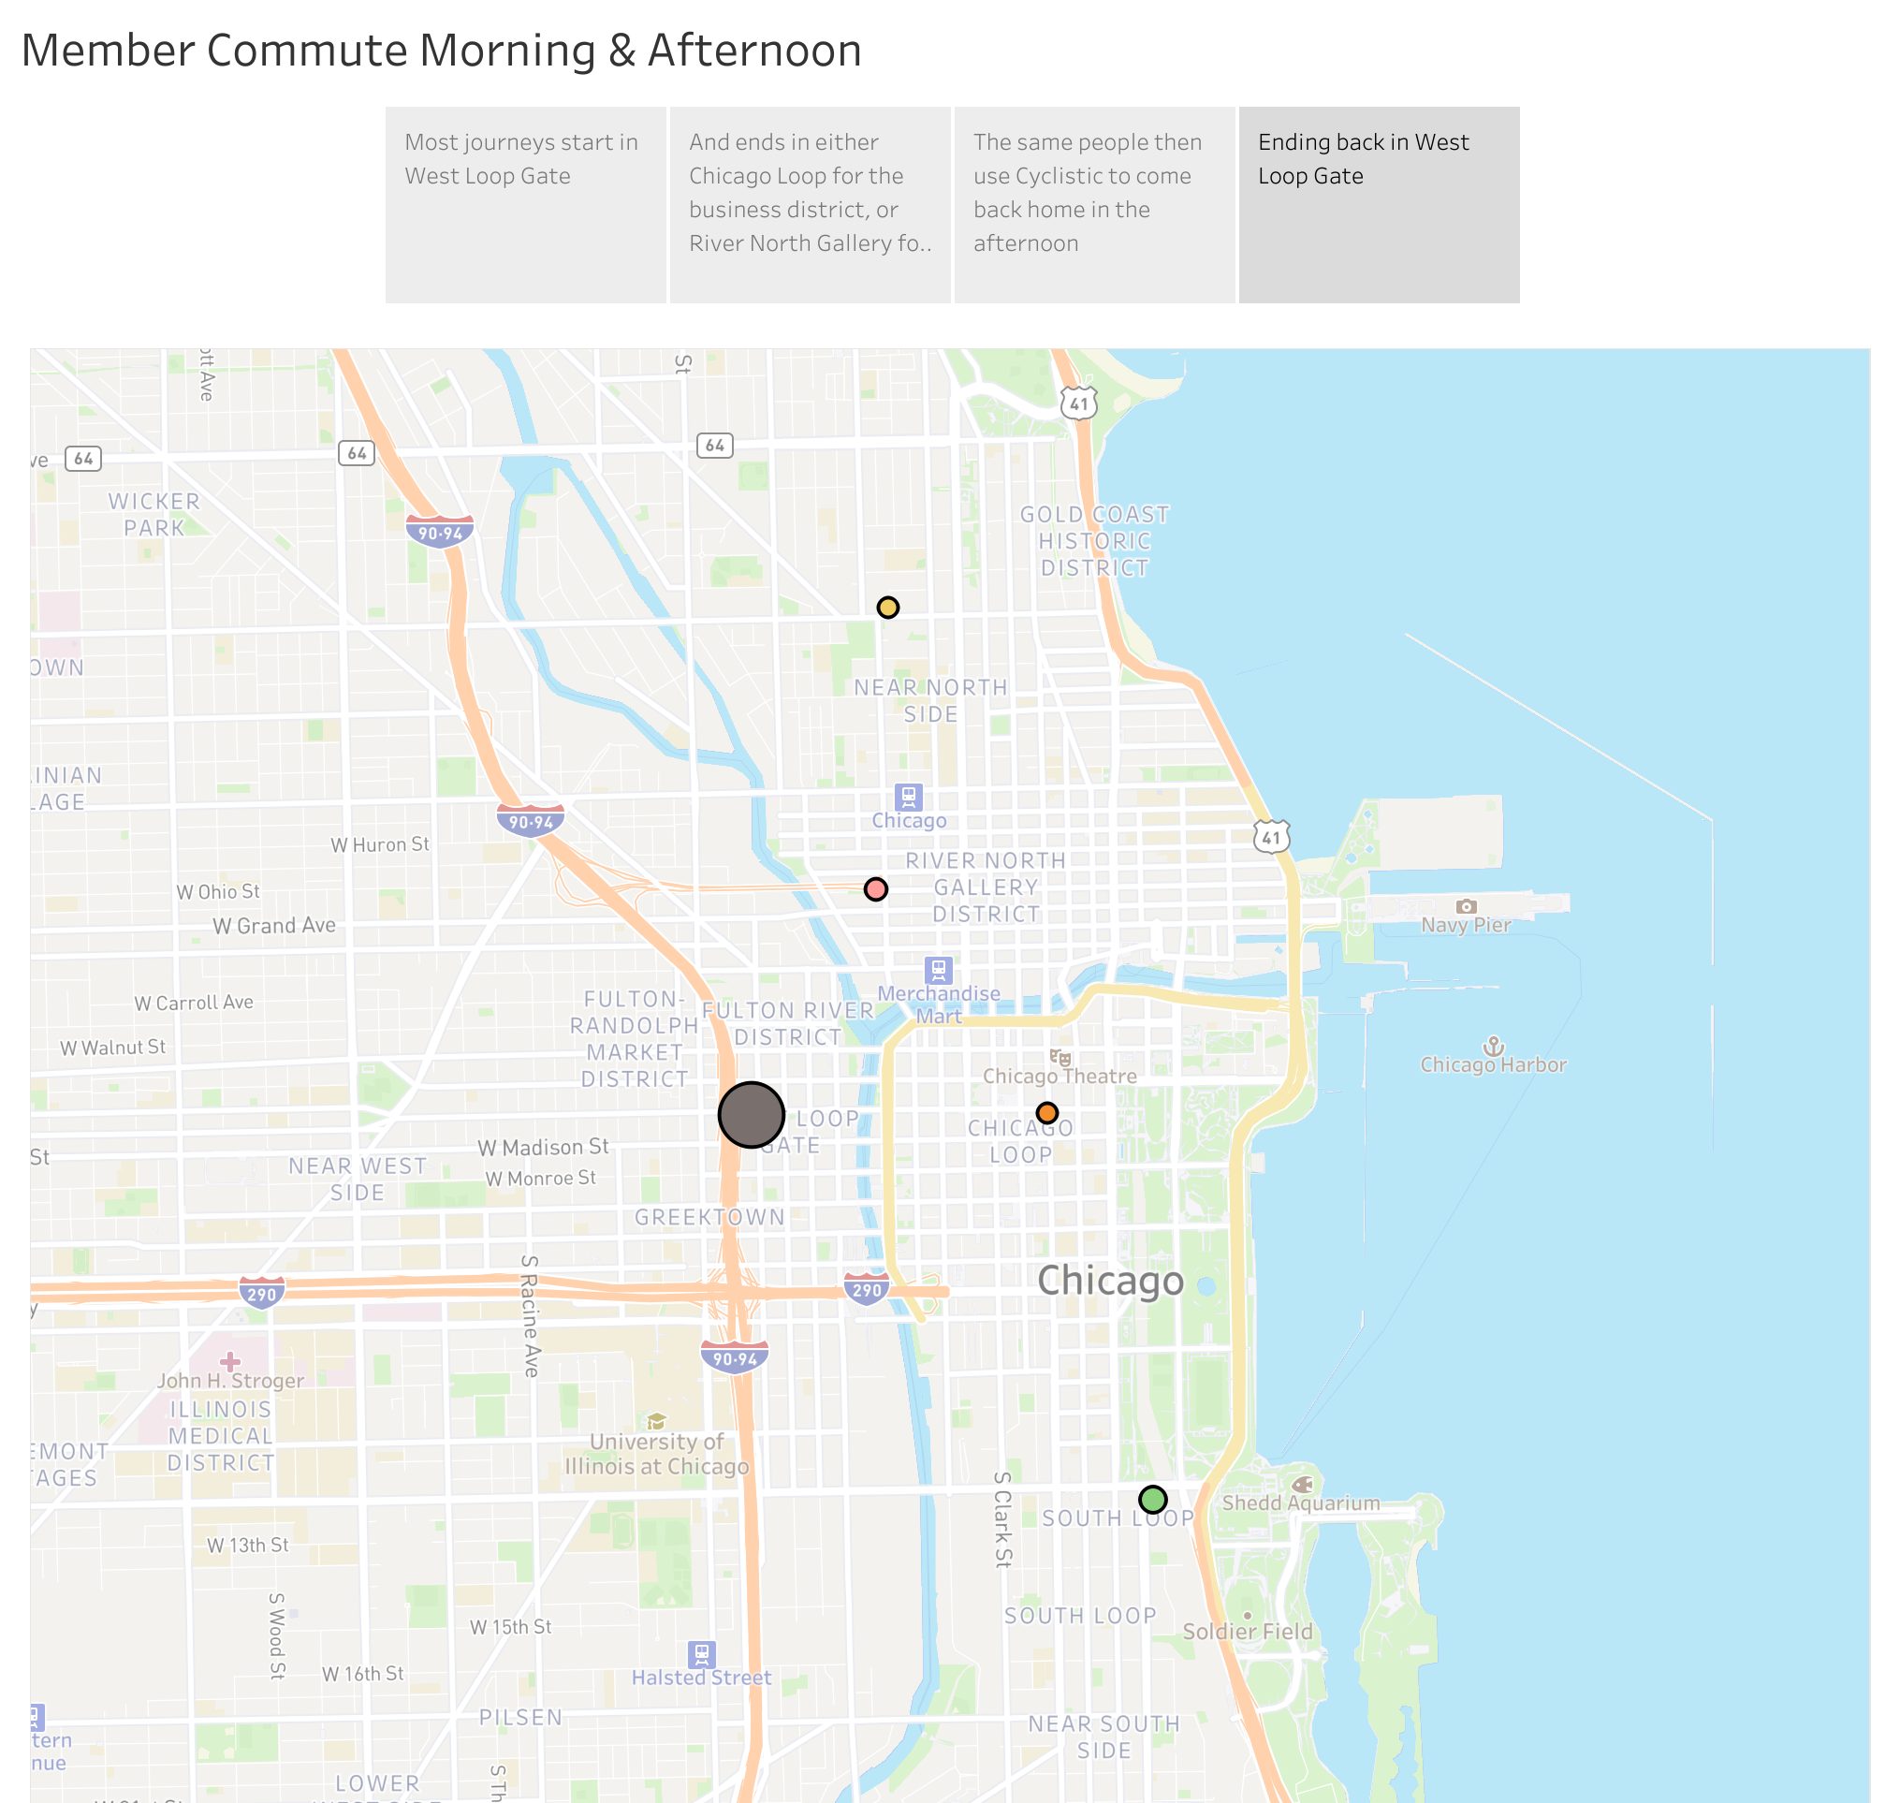
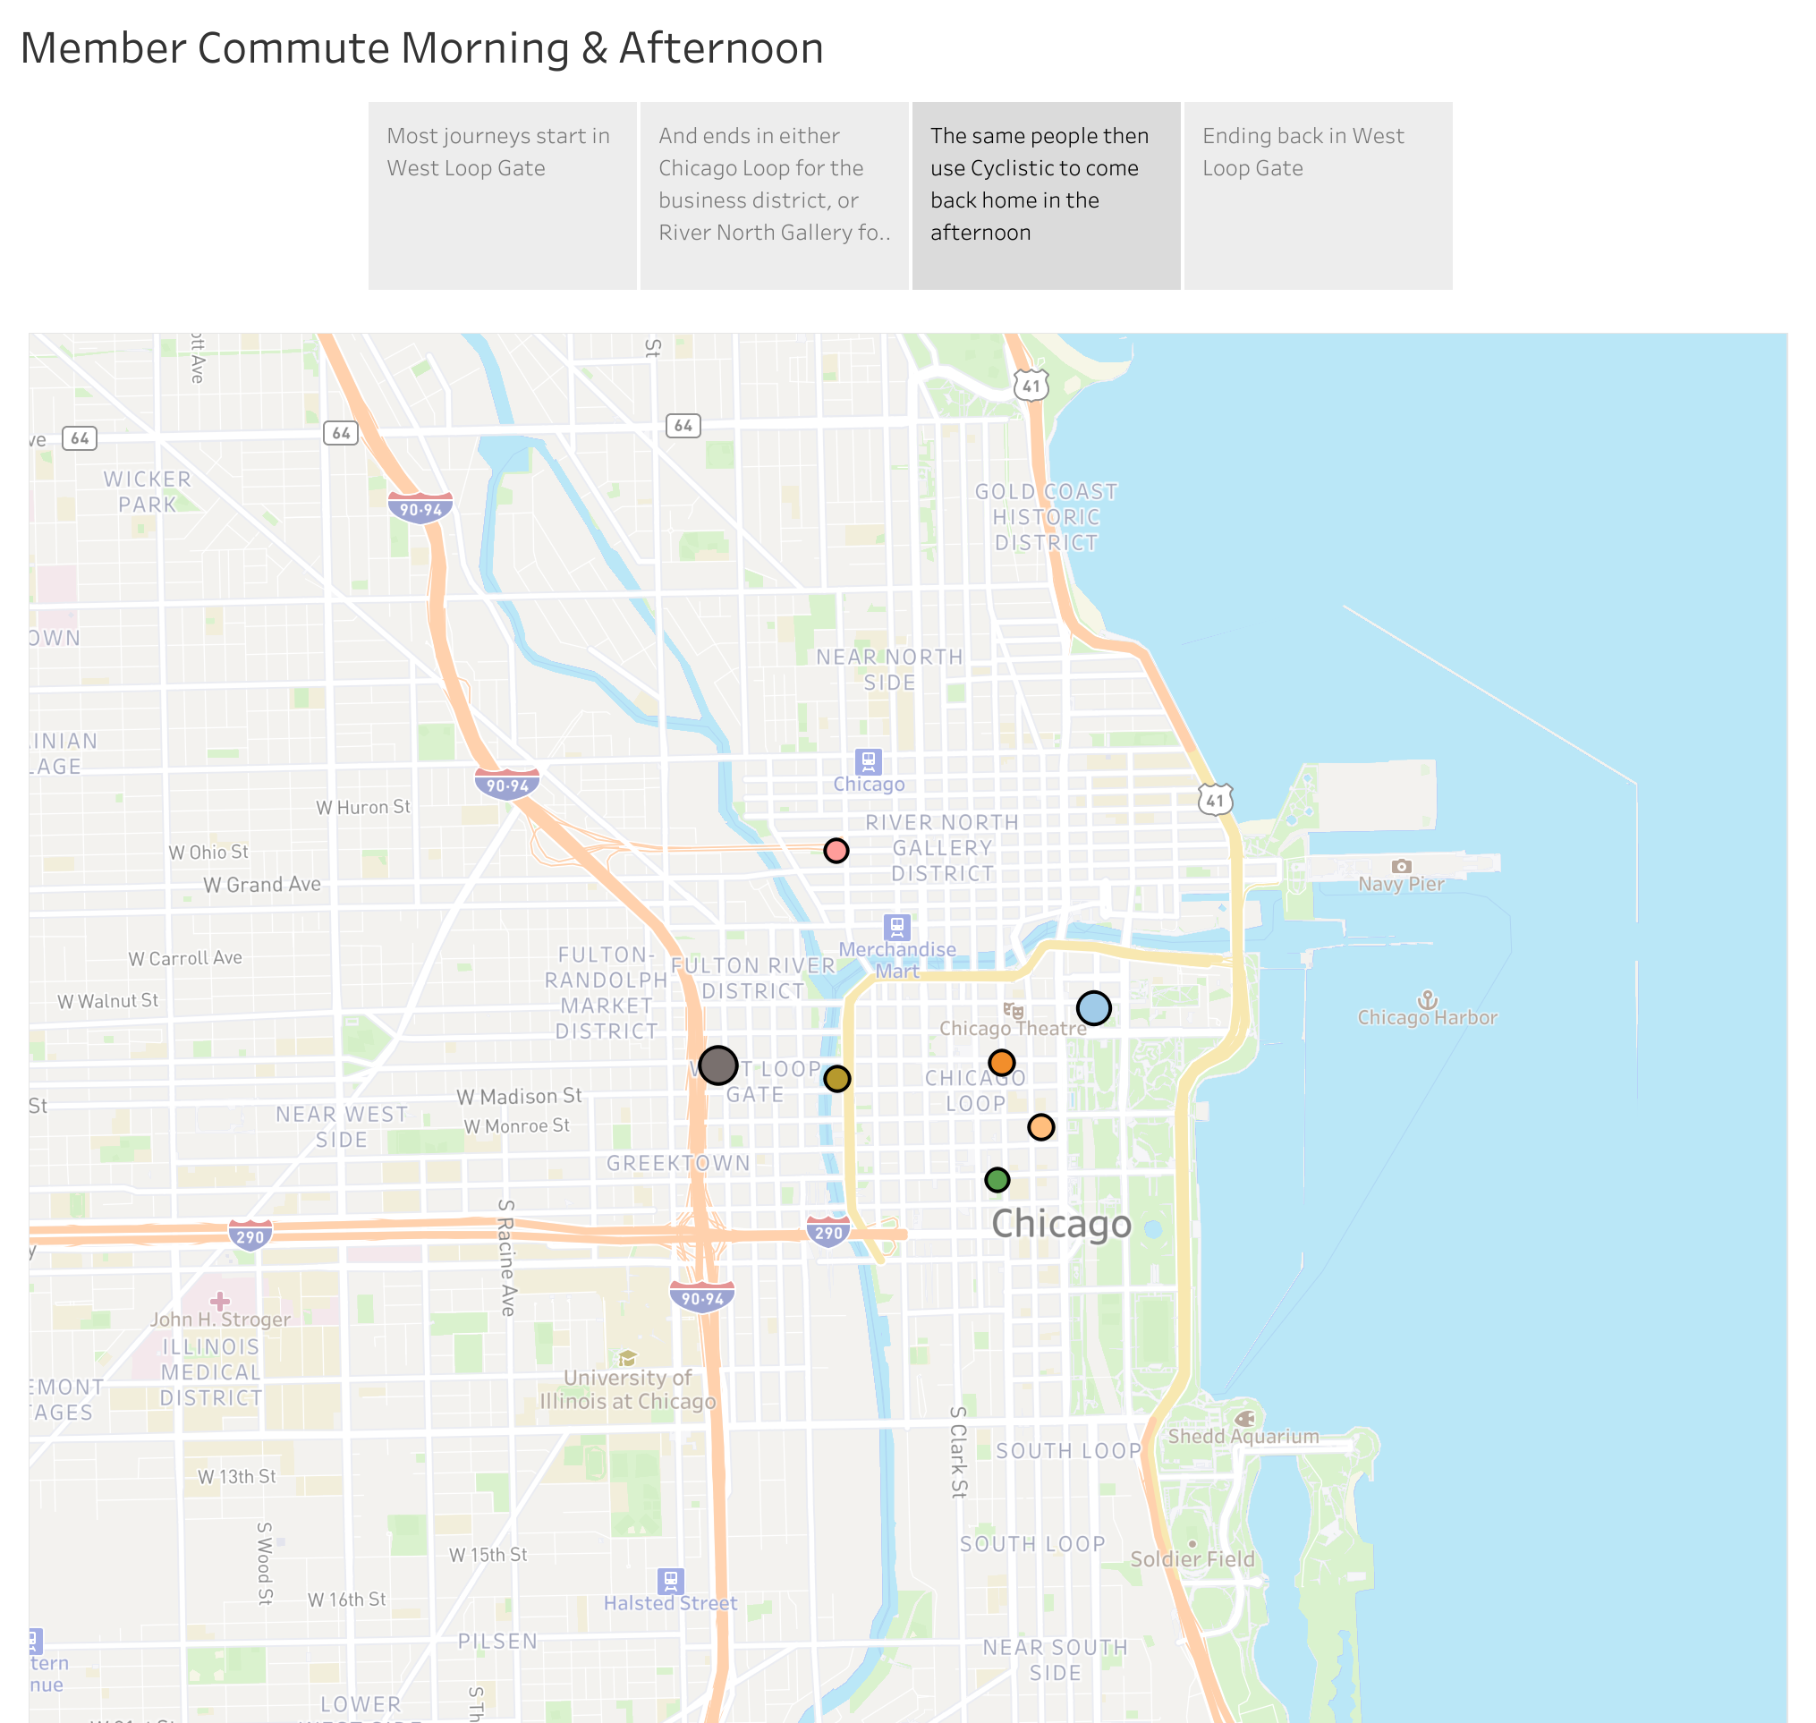
Afternoon commute start to end
People then use Cyclistic to come back home in the afternoon
Afternoon Commute
Ending back in West Loop Gate
Notes:
The commute home is a similar story in reverse, with most arriving back in West Loop Gate.

Slide 10
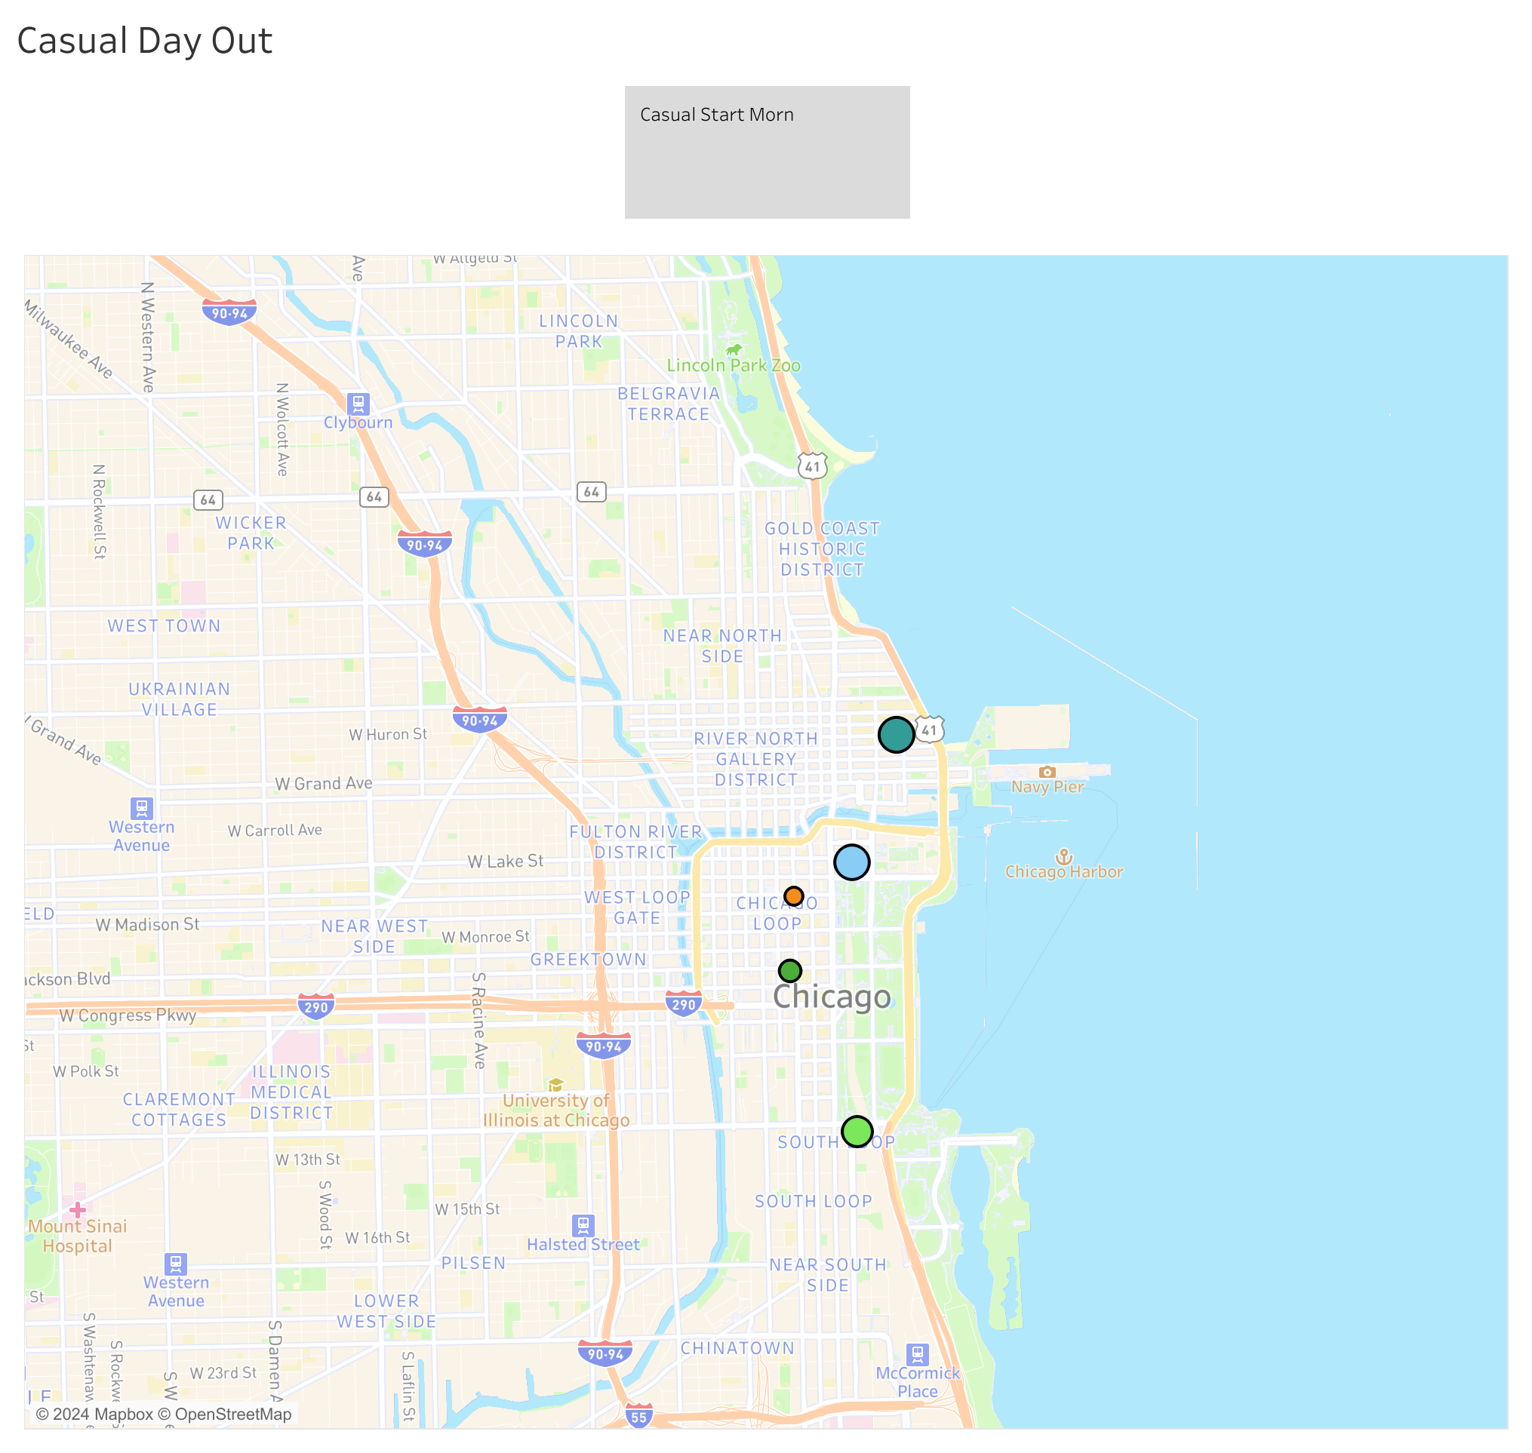
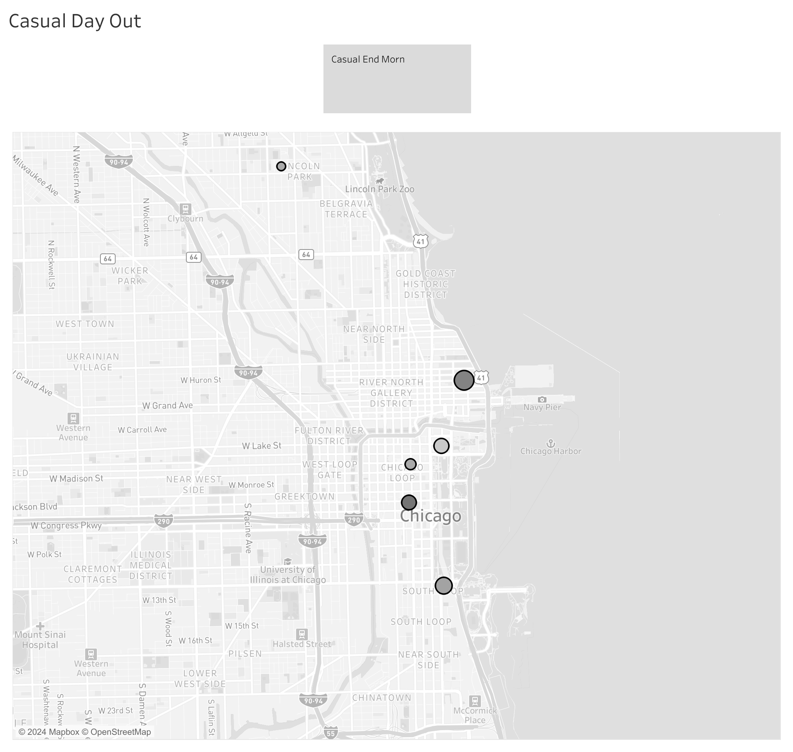
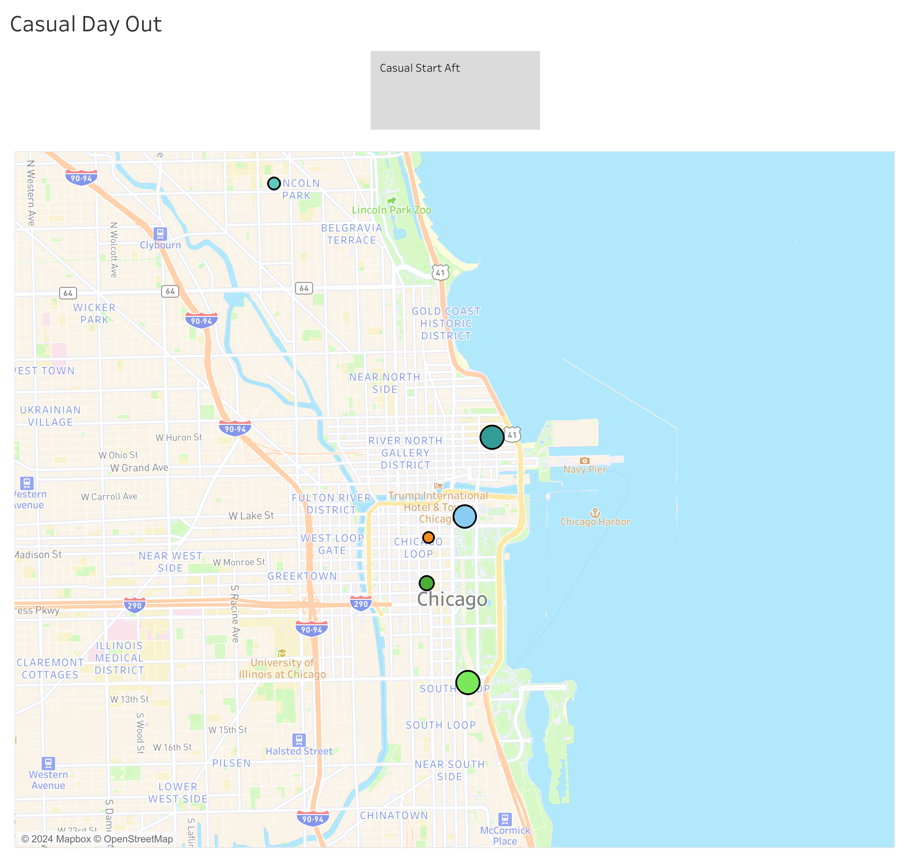
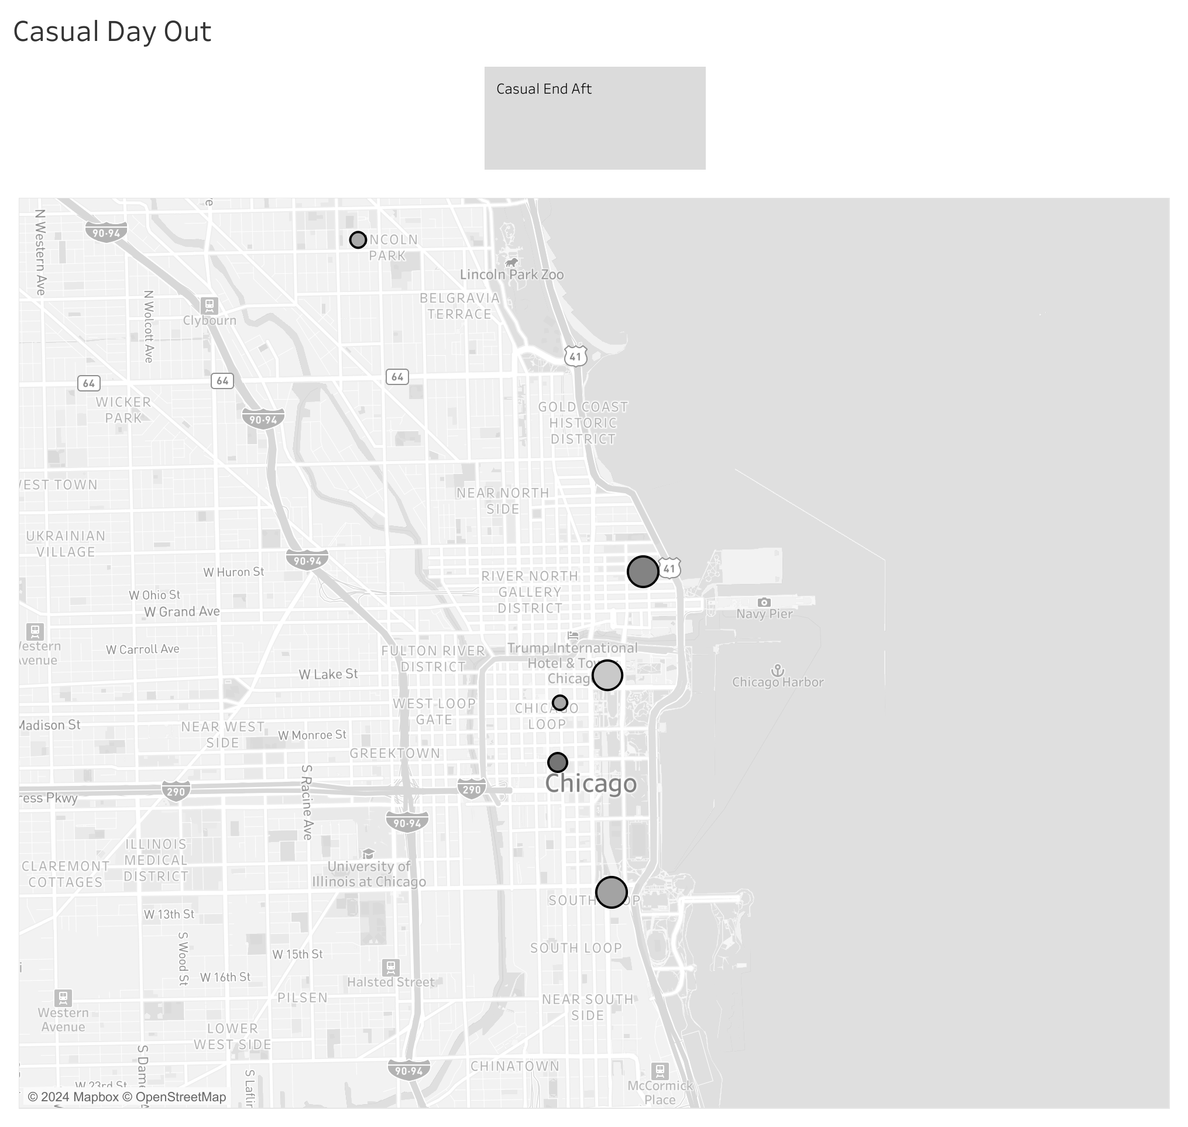
Casual Day Out – start to end
Morning Start
Morning End
Afternoon Start
Afternoon End
Notes:
Casual Users tend to track up and down the 2 mile stretch between the Navy Pier and the Field Museum called the Lakefront. Occasionally some of them might venture into the Chicago loop, but more often than not, people are using the parks and enjoying the shores of Lake Michigan.

Slide 11
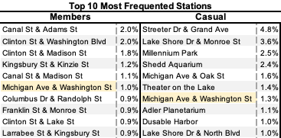
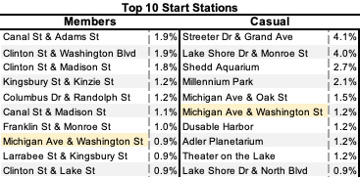
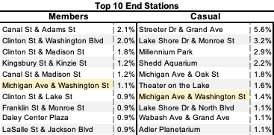
The ‘Nitty Gritty’: Frequent Stations
Most frequented stations still make up a small proportion of overall journeys, therefore it is key to look at the wider area they occupy
There is little correlation between the most used stations for casual riders and members
Stations near recreational areas see significant traffic for casual members
Notes:
Most start and end stations are the same, however it should not be inferred that trips are circular in nature.

Slide 12
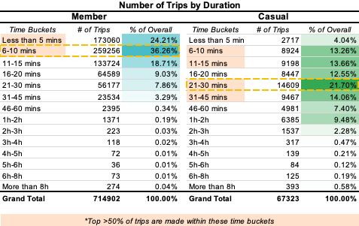
The ‘Nitty Gritty’
Quick trips are most likely to be taken by members, whereas casual riders are most likely to take their time [cycling up the lakefront!].

Slide 13
Recommendations & Next Steps
The initial task here has been exploratory, with the view to identify and quantify the differences between members and casual users of Cyclistic
The data suggests that casual riders would be likely to take out annual memberships if they are regularly cycling for recreation, however further data is required to investigate this hypothesis
In order to fully realise the potential of this data, it is recommended that supporting demographic data is acquired, such as age of riders for all datasets, so that tailored advertising content can be created to increase ridership
Next Steps
Anonymised ridership demographic data should be collected as part of the sign-up process
On the ground surveys at key stations should be undertaken throughout the year at different times of day to qualify user behaviour
Purpose of ride; membership considerations; actual start and end destinations for a person’s full journey

Slide 14
Appendix

Slide 15
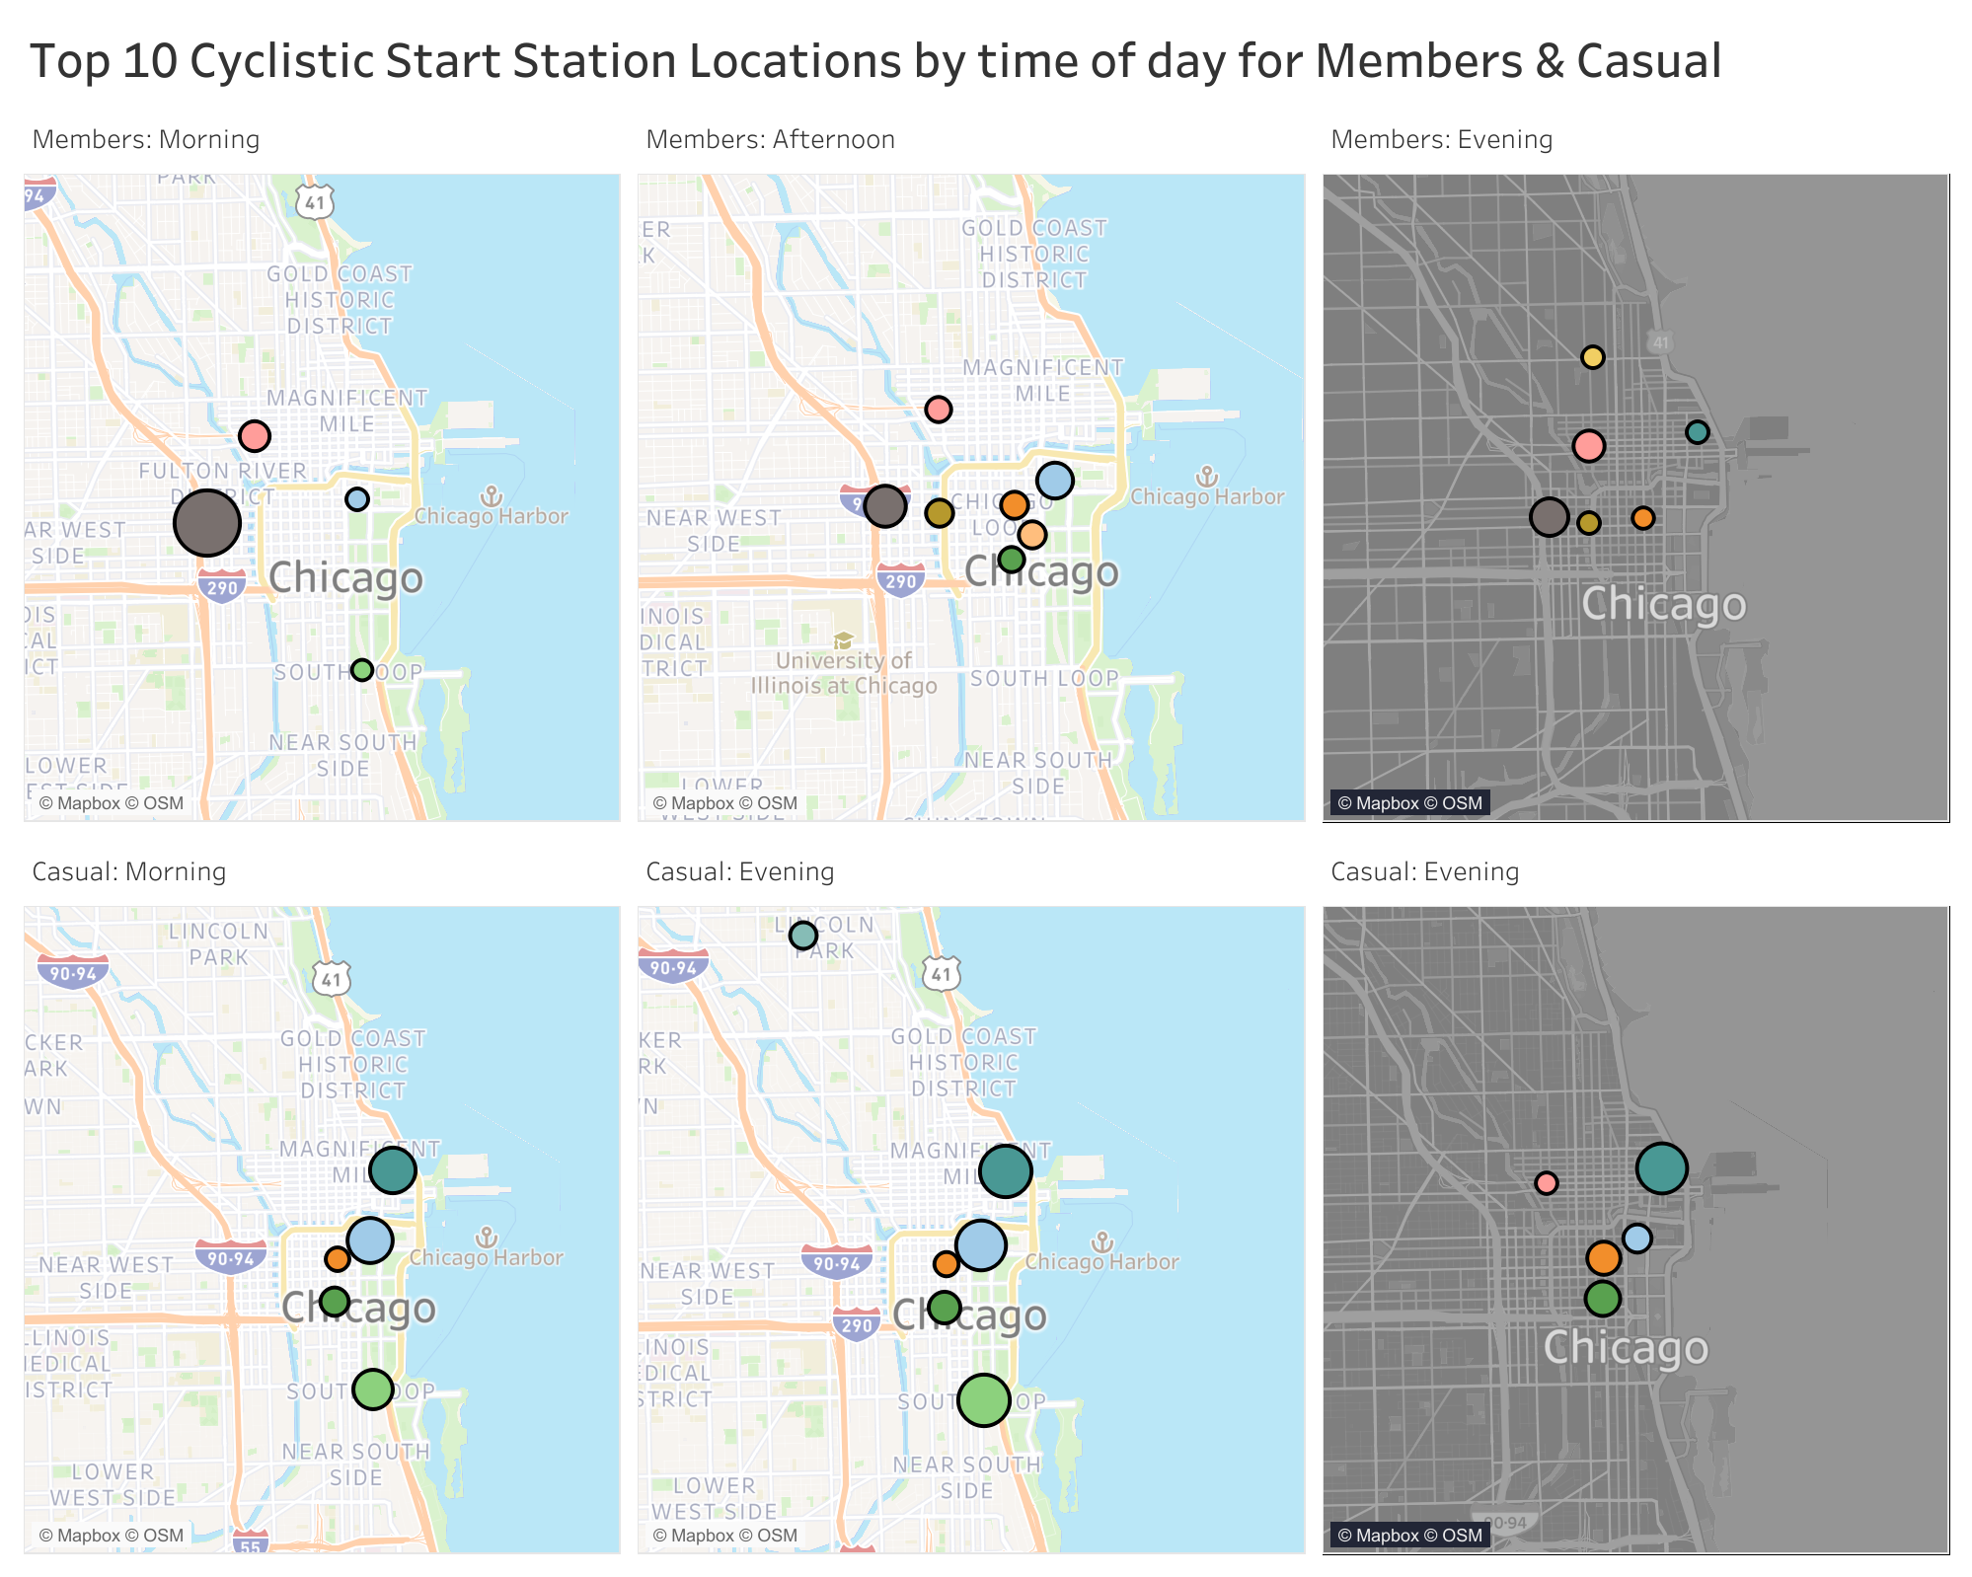
Apx 1: Member start locations
Morning
Afternoon
Evening
Notes:
So we have established when people are most likely to use Cyclistic, but what this mean when translated onto a map of Chicago? For members, we can clearly see that there is a concentration around West Loop in the morning, and Chicago Loop in the afternoon, indicating a commute into the business district and back. By evening, things are more subdued and fewer journeys are being made.

Slide 16
Apx 2: Casual start locations
Morning
Afternoon
Evening
Notes:
Casual riders tell a tale of enjoying the lakefront as the primary use case for Cyclistic. This largely drops off into the evening.

